Slide 1


Vidya Pratishtan’s Art’s, Science & Commerce ,College Baramati, Dist : Pune-413133 A Project report on: Digital Notice Board
Group Members :
Kakade Akash (57)
Kale Ranjit (59)
Chandgude Rohan (14)
Guided By :
Mr. Joshi Sir
(HOD)
Mrs.Khetre Madam
(Project Guide)

Slide 2
INTRODUCTION
Abstract
Motivation
Problem Statement
Goals of the System
Literature Survey
Project Scope & Limitations

Slide 3
ABSTRACT
Digital Notice Board System website is used is to display notices to student posted by teacher . Student can read the notice. By using this application we can maintain notice records of various classes.
Primary task of this project is store the teacher and student information into database and only notice teacher can post notices.
By this application teachers can easily communicate with students and vice versa.

Slide 4
MOTIVATION
In this era, almost everything is digital except few things like notice boards.
It is very necessary to become digital these days as it reduces manual work and to make life quite simpler.
To reduce the manual work which includes writing manually the notices or taking print outs or visiting personally to notice board for checking notices

Slide 5
PROBLEM STATEMENT
The notices displayed on physical notice board were paper based which means there are chances of paper getting ripped, untidy, etc which may have resulted in unreadable data.
If any student remains absent then it was difficult for him to get to know about the updates from his college as he had to physically go to college and check the notice board.
Even the person who wanted to share the notice he/she had to take a print out or write it manually using paper and pen and display on that physical notice board.
To overcome above mentioned problems we decided to make website named Digital Notice Board System for both Teachers & Students.

Slide 6
OBJECTIVE & GOALS
The main Objective of “Digital Notice Board” is to create an interface between Teacher’s and Student’s for displaying notices digitally by reducing efforts and time.
Goals :
To display notices digitally , by the help of website to reduce time and efforts.
It will help both(Students & Teachers)
Can have record of all Notices.
Simple to Use & Reliable.

Slide 7
LITERATURE SURVEY
The system uses a web interface to allow users to post messages and announcements, which are then displayed on the Website.
Which will be Beneficial for the Students .
Easy to Use.
Reduces Efforts to visit the place.

Slide 8
PROJECT SCOPE & LIMITATIONS
To reduce the manual work which includes writing manually the notices or taking print outs or visiting personally to notice board for checking notices.
To replace physical notice boards with e-notice boards for efficiency and durability.
To keep all record of all notices , uploaded anytime.

Slide 9
SYSTEM ANALYSIS
Existing system
Scope and limitation of Existing system
Project perspective, features
Stakeholders
Requirement analysis:
1.Functional requirements,
2.Performance requirements,
3.Security requirements .

Slide 10
EXISTING SYSTEM
Initially, the notice board was physical that means students had to actually go and find the notice board to view the latest notices. It resulted in a quite chaotic situation. Even the person who wanted to share the notice he/she had to take a print out or write it manually using paper and pen and display on that physical notice board. The existing system forces both student and teacher/admin to physically move from the original place to view the notices.
This consumes a lot of time for both of them. If incase the teacher displays notice on notice board which is quite important and urgent response has to be taken from students then it’s difficult for students to know about it, as there is no way that students are informed that some notice has been displayed on the board. This was kind of troublesome situation for both student and teacher.

Slide 11
SCOPE & LIMITATION OF EXISTING SYSTEM
Scope of Existing System:
1) Does not require Internet Connection.
2) No need to create profile.
Limitations of Existing System:
1)Time Consuming – For knowing that notice are displayed and going to see that is time taking process & taking print or writing notice is also time consuming for teachers.
2)Compulsary need to be present – to see the Notice Students need to be there present .

Slide 12
PROJECT PERSPECTIVE-FEATURES
Perspective:
The DIGITAL NOTICE BOARD will make a significant difference. The Students and Teachers will get a new and amazing overall digital experience and easy to use handy feature and convenient by their use. And user friendly website for both.
Features:
The DIGITAL NOTICE BOARD keep tracks of all the record inserted in it. Multiple accounts cannot be created through same mail.
Reduces Manual work & Foucues on Digitalizing it and maked User Friendly.

Slide 13
STAKEHOLDERS
The main Stakeholders in our project are the Teacher’s and Student’s. The System is mainly design so that they can connect with each other whenever required.
Both need to log in by using username and password to log in.

Slide 14
REQUIREMENT ANALYSIS
1. Functional Requirements:
There is not any restriction of time to register or access the site only stable internet connection is requires then it will be available 24 Hours a day .
Teacher’s(Admin) & Students should be able to update his/her information. Admin can Update , Post , Add and Delete Notice .
Whereas Student’s can see , edit their profile and reply to the notices. Which are posted by teachers.

Slide 15
REQUIREMENT ANALYSIS
2. Performance Requirements:
DIGITAL NOTICE BOARD does not have any limit to the number of Students to store.
Records are well sorted and each donor data has a unique id.
This site can be accessed through any browser with stable internet connection

Slide 16
REQUIREMENT ANALYSIS
3. Security Requirements:
Website is well secured from attacks and Phishing . So that accessing the database is not possible because of Encryption.

Slide 17
SYSTEM DESIGN
ER Diagram
Class
Logid
Name
Email
Password
Rno
Password
Student
Admin
M
Detail
1
Title
Class
N_id
Timestamp
View
N
otice
Add
M
M

Slide 18
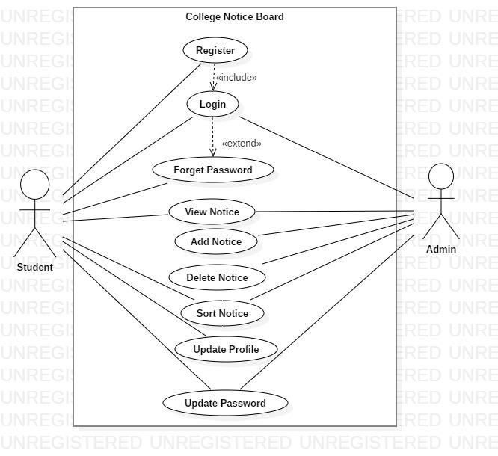
UML DIAGRAM
Use Case Diagram

Slide 19
CLASS DIAGRAM
.
Student
Admin
#
Rno
:
int
#
Log
_id: varchar (20)
+
Name: varchar (50)
-
Password: text
+
Class: option
#Email: varchar (20)
-
Password: text
+
View_Notices ()
+
View_Notices ()
+
Add_Notices ()
+
Sort_Notices ()
+
Sort_Notices ()
+
Update_Profile ()
+
Update_Profile ()
+
Update_Password
+
Update_Password ()
()
Deletes
1
Inserts
Sort
Sort
View
M
Notice
-
N_id
:
int
#Title: varchar (30)
M
M
#Detail: varchar (100)
#Class: option
-
Time: timestamp

Slide 20
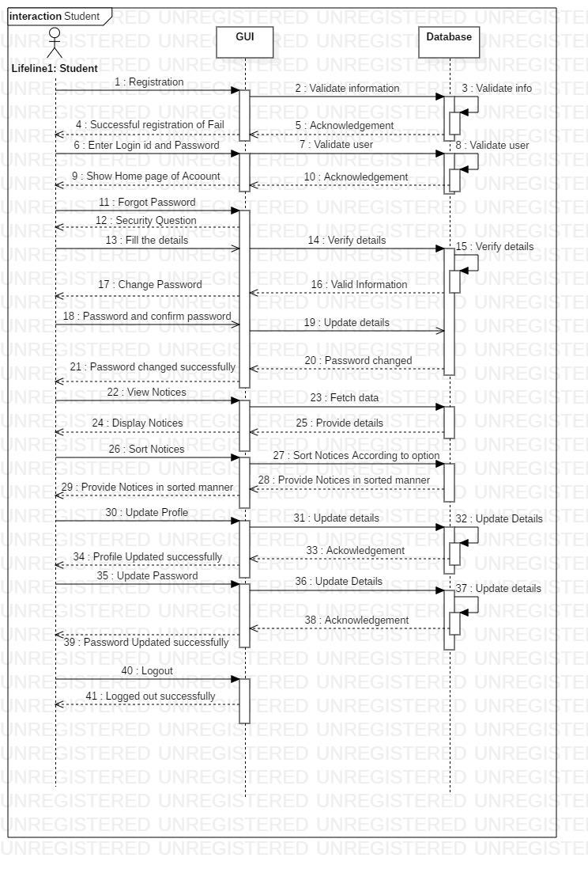
SEQUENCE DIAGRAM - STUDENT
SEQUENCE DIAGR
AM
.

Slide 21
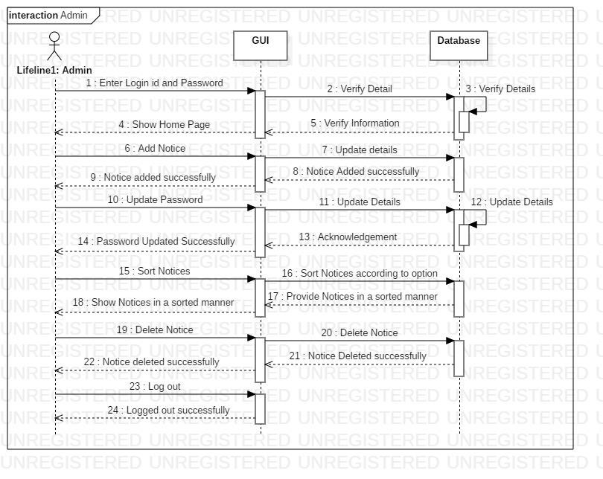
SEQUENCE DIAGRAM - ADMIN
.

Slide 22
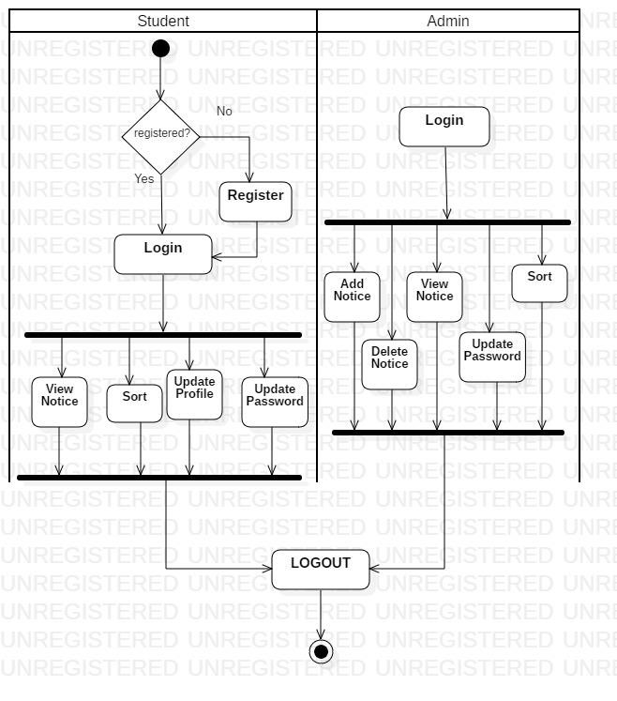
Activity Diagram
.

Slide 23
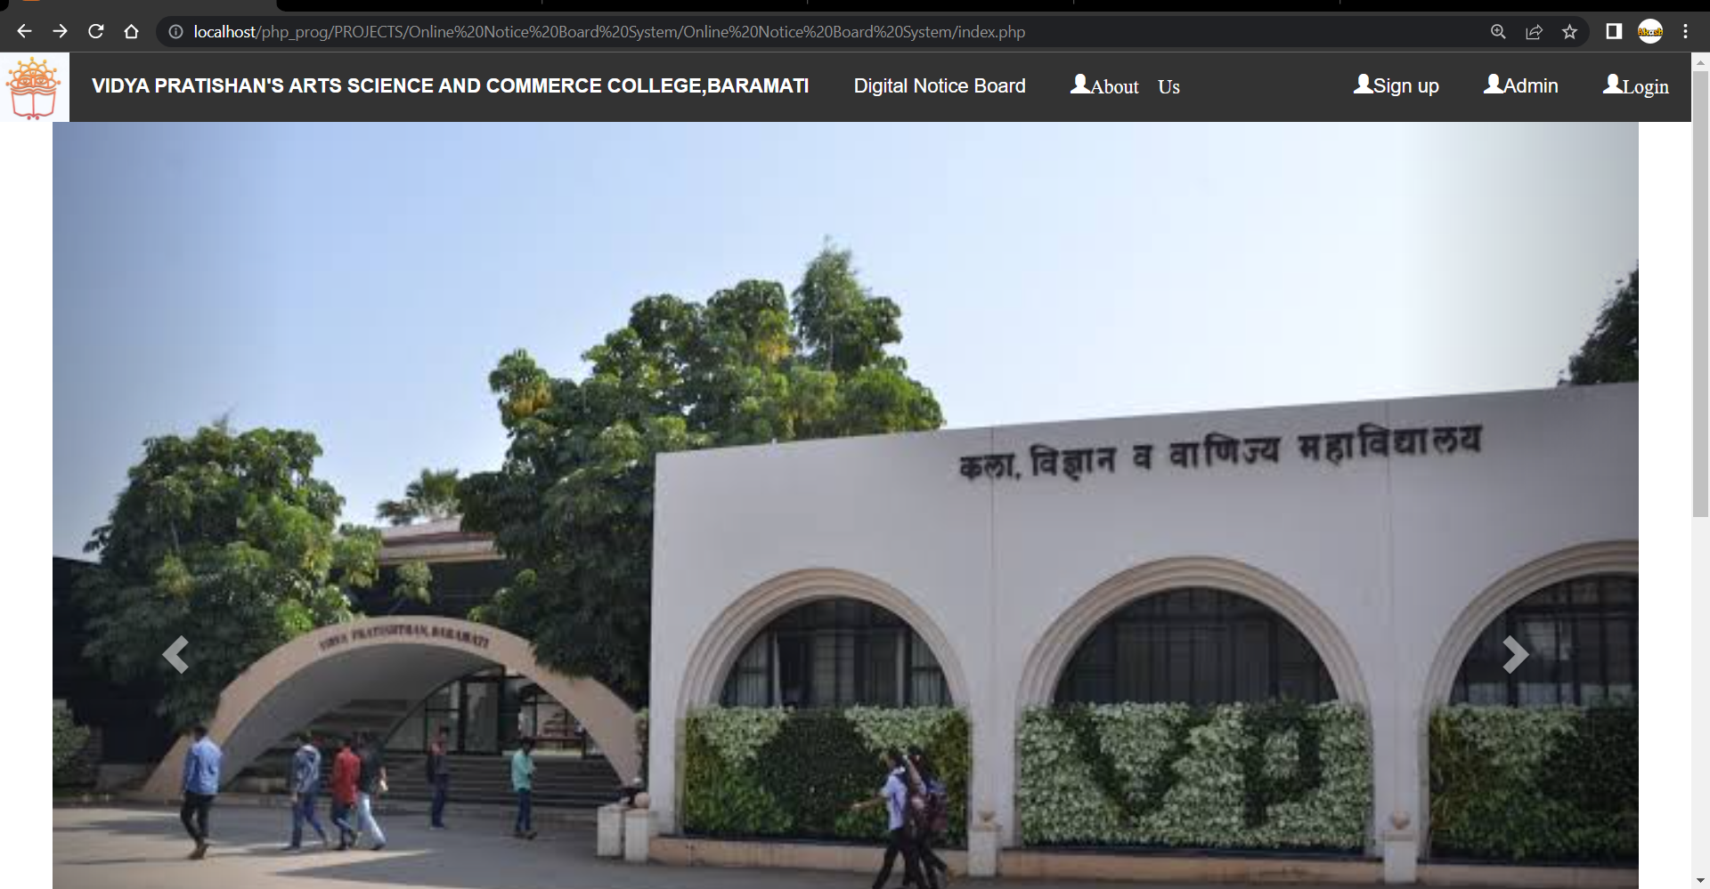
OUTPUTS AND RECORD TESTING
1. Home Page

Slide 24
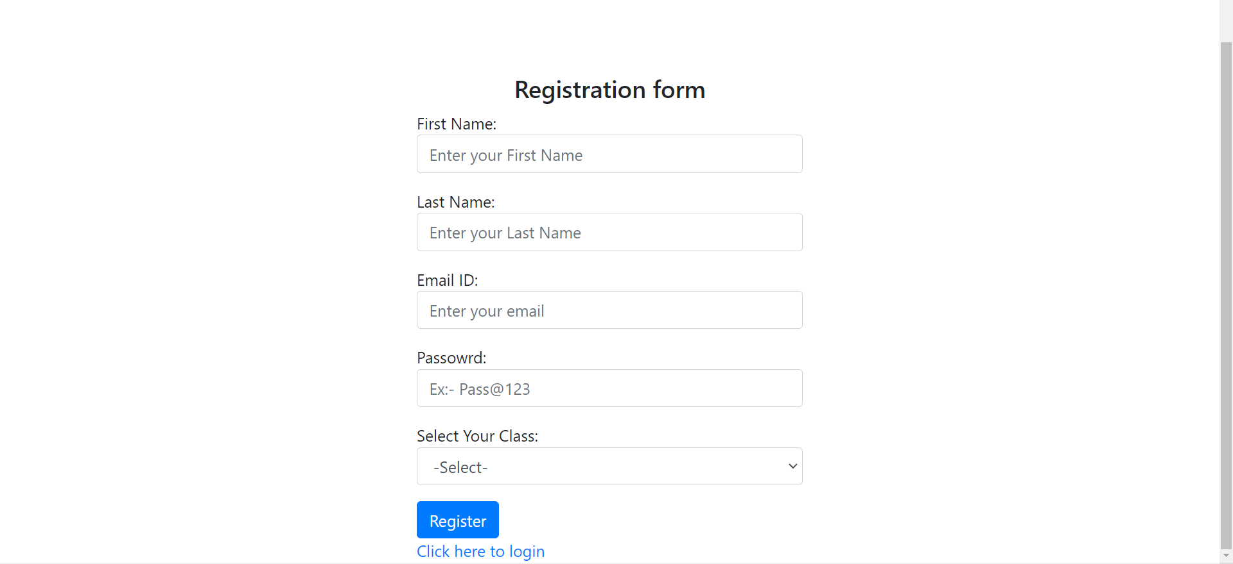
SIGN UP (REGISTRATION PAGE)

Slide 25
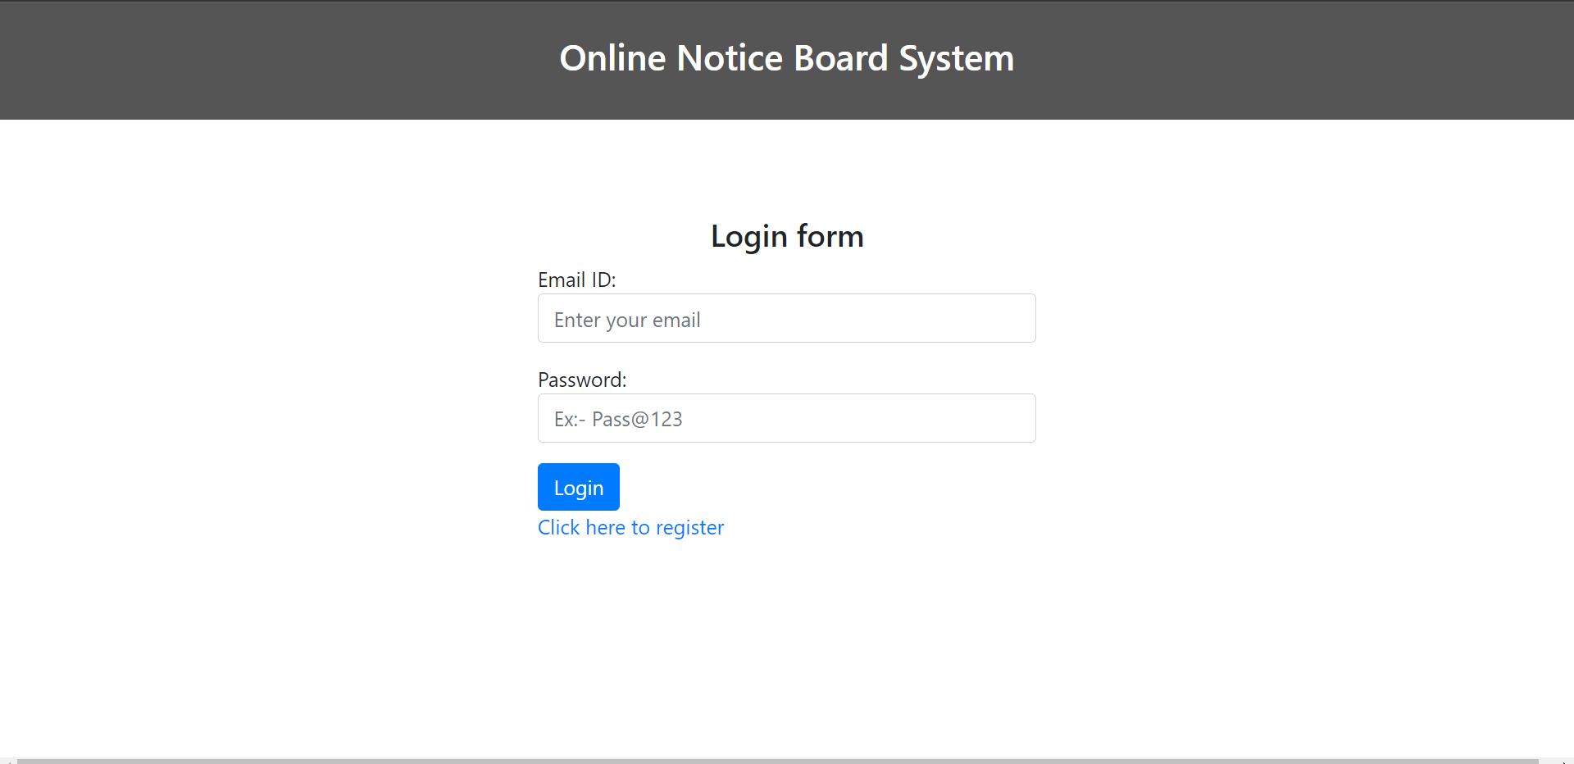
LOG IN PAGE

Slide 26
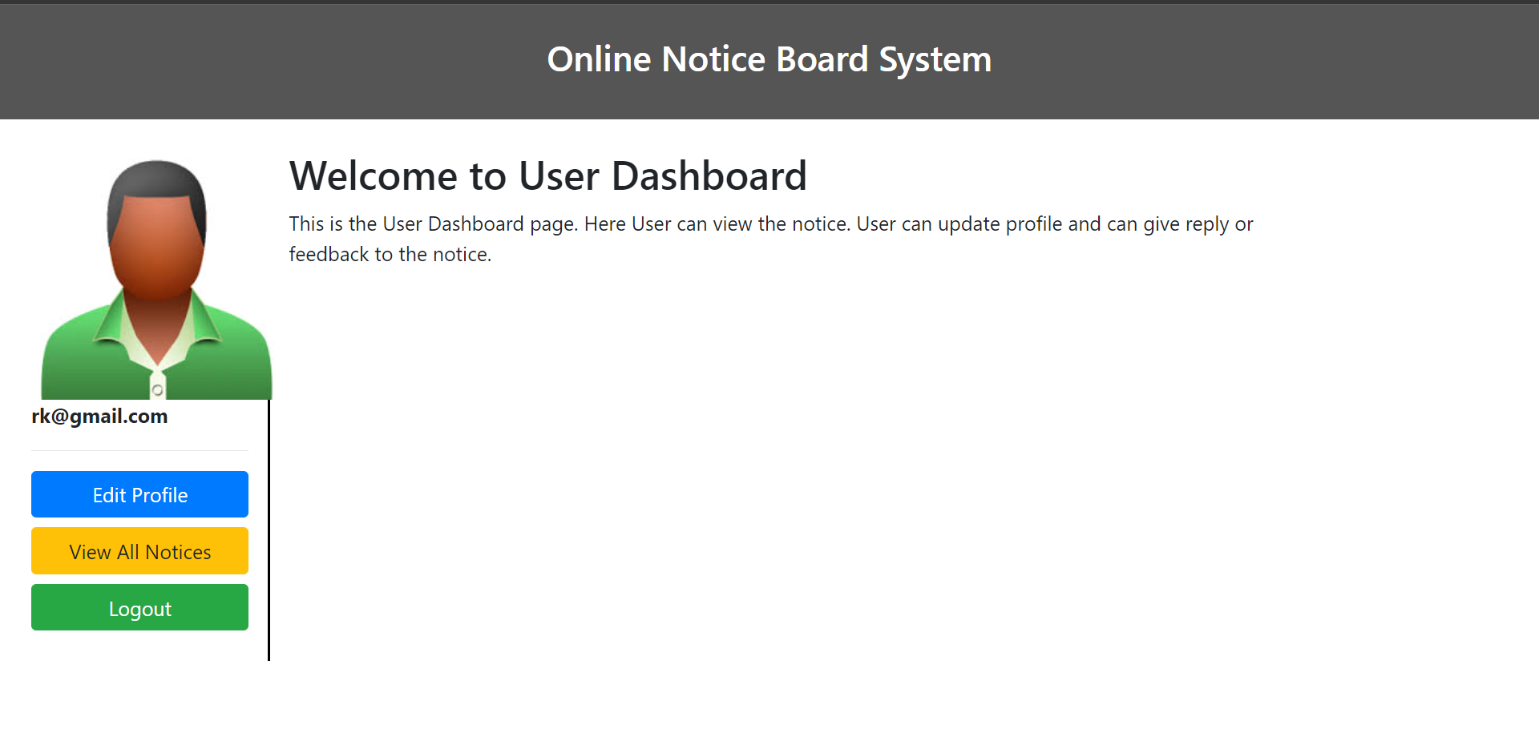
USER DASHBOARD

Slide 27
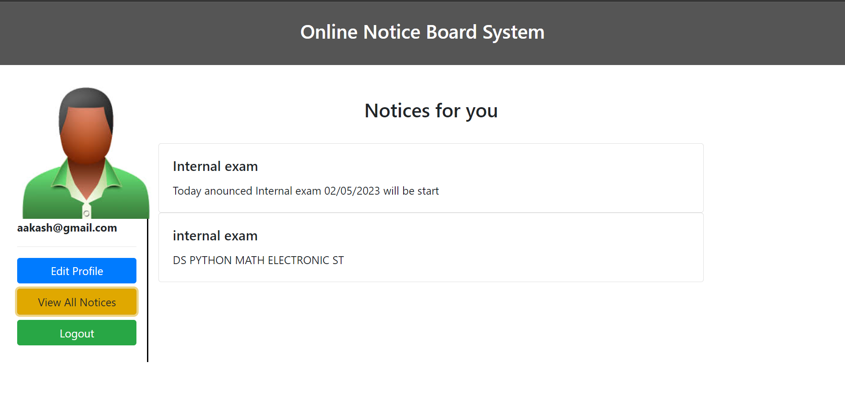
USER ALL NOTICES

Slide 28

ADMIN LOGIN

Slide 29
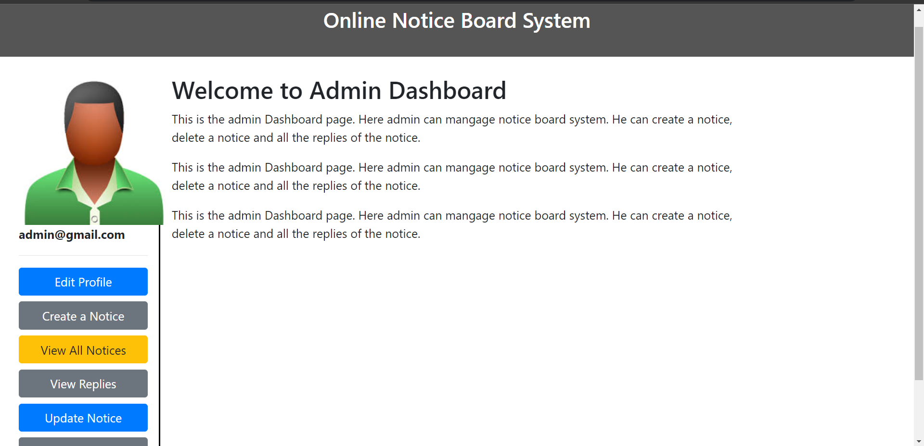
ADMIN DASHBOARD

Slide 30
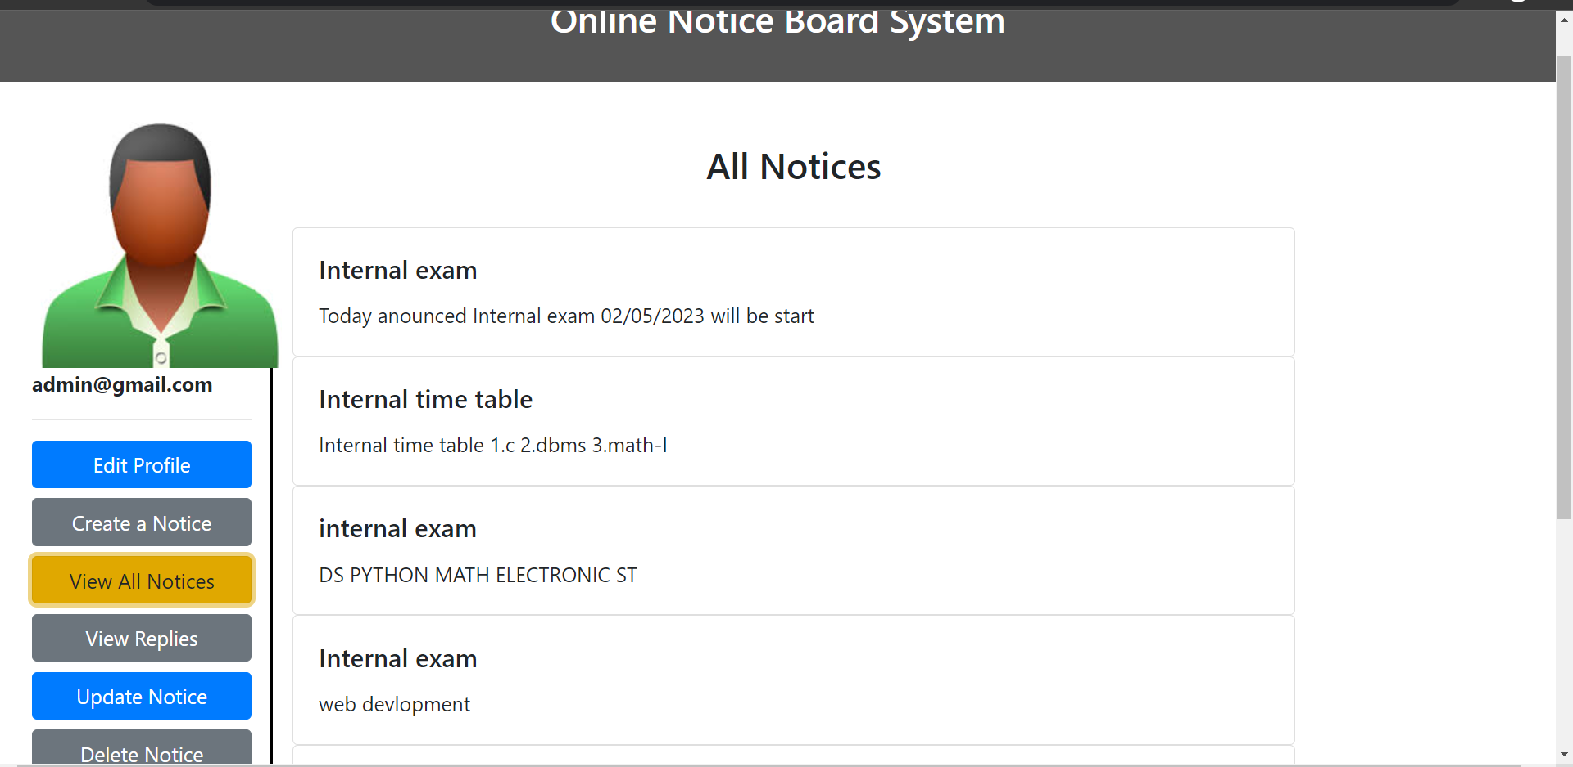
ADMIN ALL NOTICES

Slide 31
CONCLUSION
The Digital Notice Board System is mainly design to reduce manual work and making it easier for both Students and Teacher’s.
Available 24 hours a day , Available everytime.
No need to physically present
Controlled Process.
Easy to adopt and manage

Slide 32


THANK YOU!!
THANK
YOU!!
.

